Slide 1
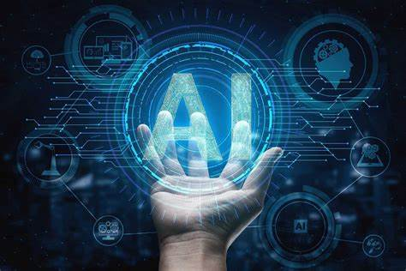
Top New Technologies in ai
SHUHAIB NSTI-CALICUT

Slide 2
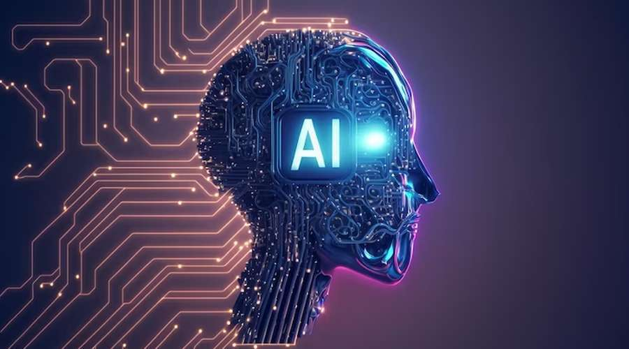
Introduction
Artificial Intelligence (AI) is a rapidly advancing field, with new and innovative technologies emerging constantly.
New and innovative technologies are constantly emerging in AI
This presentation will focus on some of the top new AI technologies that are shaping the future

Slide 3
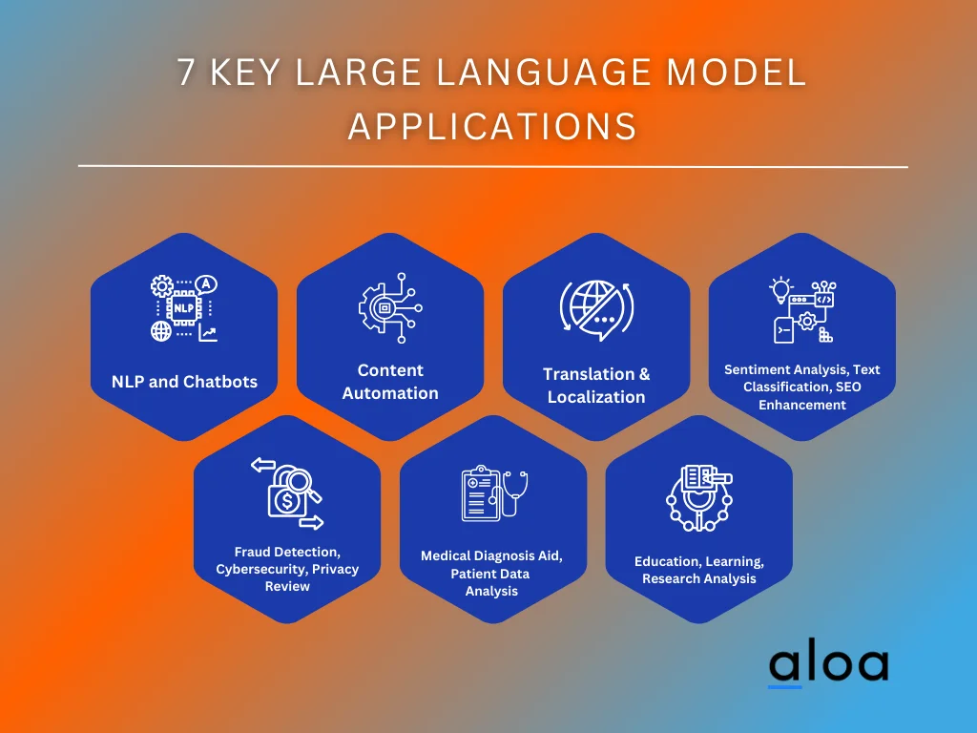
Large Language Models (LLMs)
LLMs are a breakthrough in natural language processing, allowing AI systems to understand, generate, and process human-like text.
Models like GPT-3, DALL-E, and ChatGPT have demonstrated impressive capabilities in tasks such as language translation, question answering, and even creative writing.
LLMs are revolutionizing fields like conversational AI, content creation, and knowledge management.

Slide 4
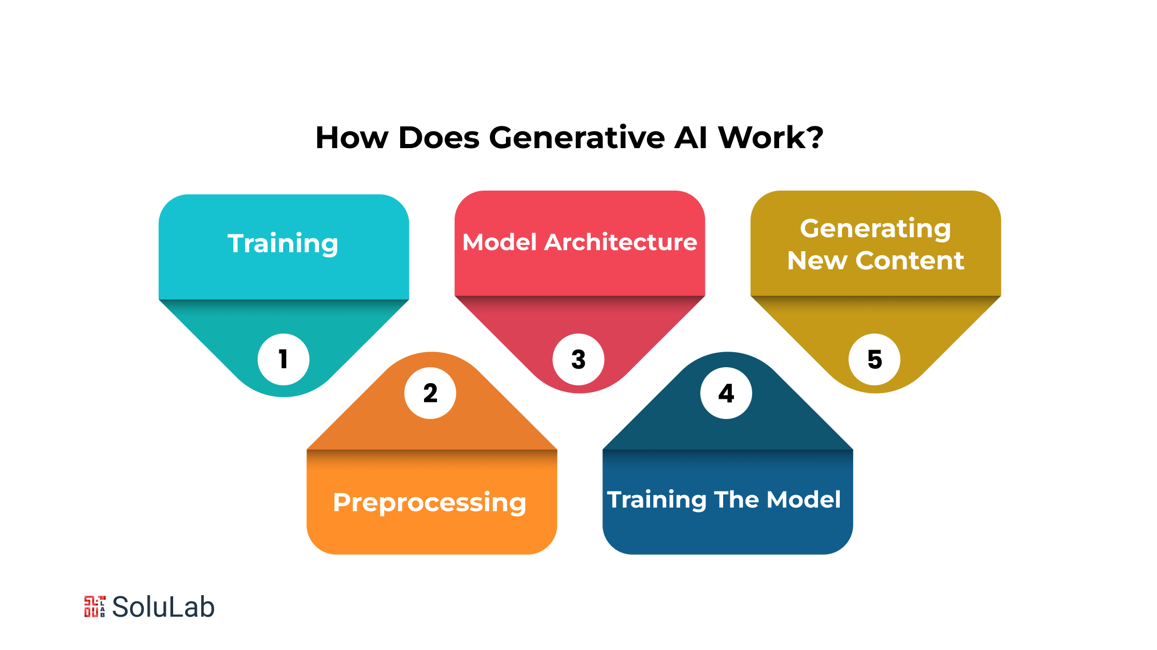
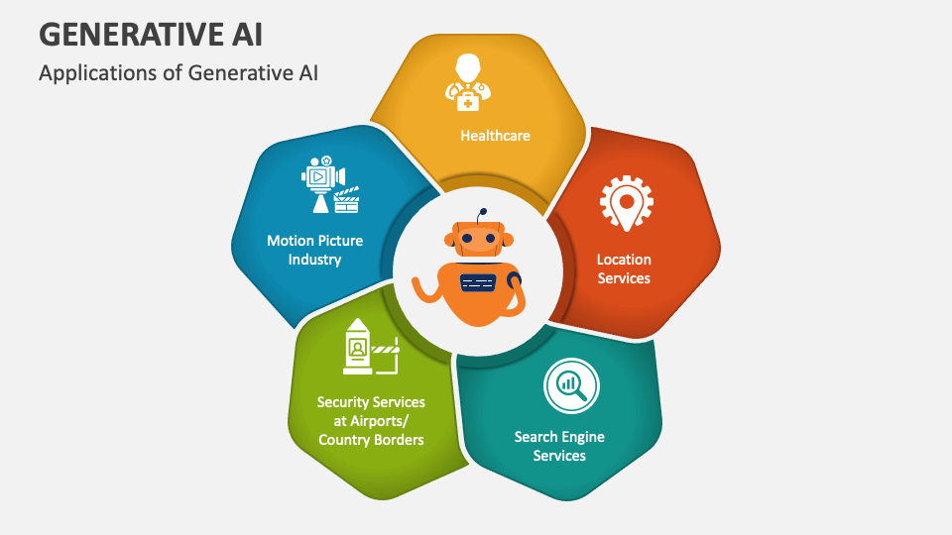
Generative AI
Generative AI models can create new, original content such as images, videos, and even music, from scratch.
These models use advanced techniques like Generative Adversarial Networks (GANs) and Diffusion Models to generate highly realistic and visually stunning outputs.
Generative AI is transforming industries like art, design, and media, enabling new forms of creative expression and content generation.

Slide 5
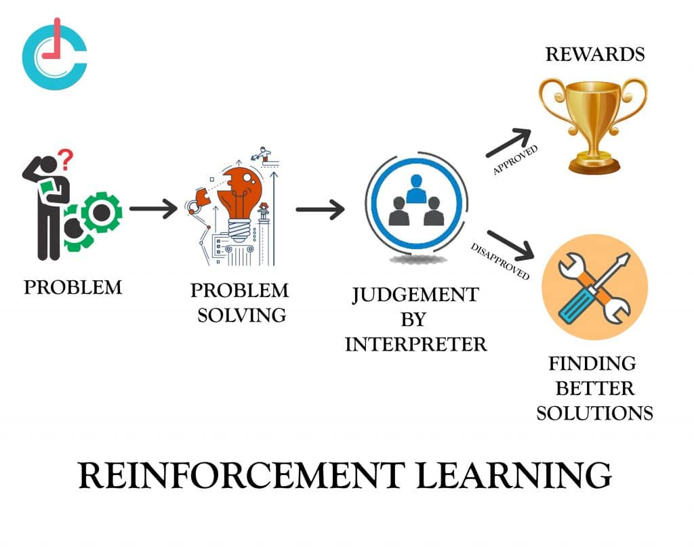
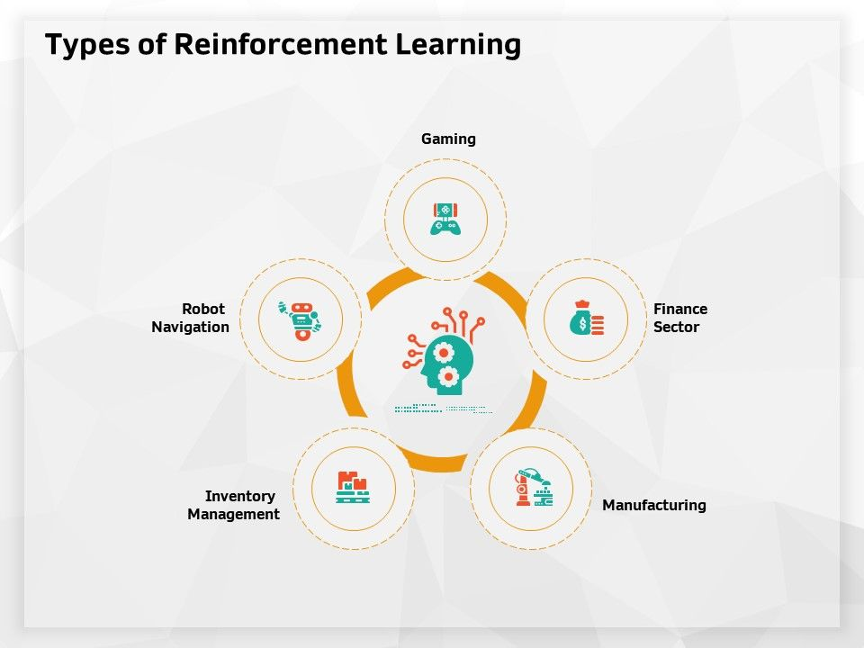
Reinforcement Learning
Reinforcement Learning (RL) is a type of machine learning where AI agents learn by interacting with an environment and receiving rewards or punishments.
RL has led to groundbreaking achievements in AI, such as systems that can outperform the best human players in complex games like Go and Dota 2.
Beyond gaming, RL is being applied in areas like robotics, decision-making systems, and autonomous vehicles.

Slide 6
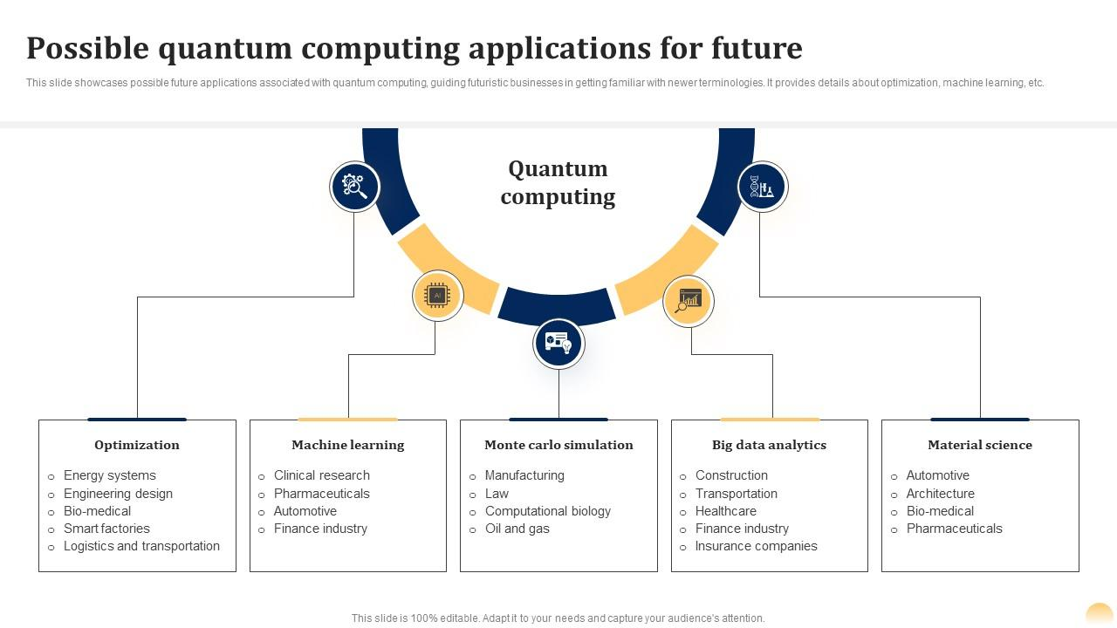
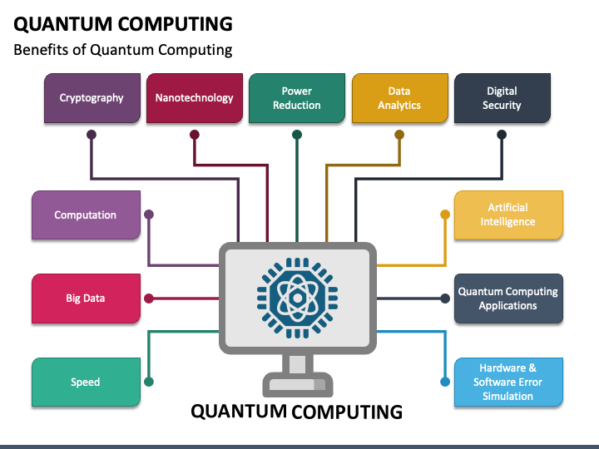
Quantum Computing
Quantum computing is a new paradigm in computing that leverages the principles of quantum mechanics to perform calculations and solve problems that are intractable for classical computers.
Quantum AI algorithms have the potential to exponentially speed up certain types of computations, such as optimization, simulation, and factorization.
This could lead to breakthroughs in fields like cryptography, drug discovery, and materials science.

Slide 7
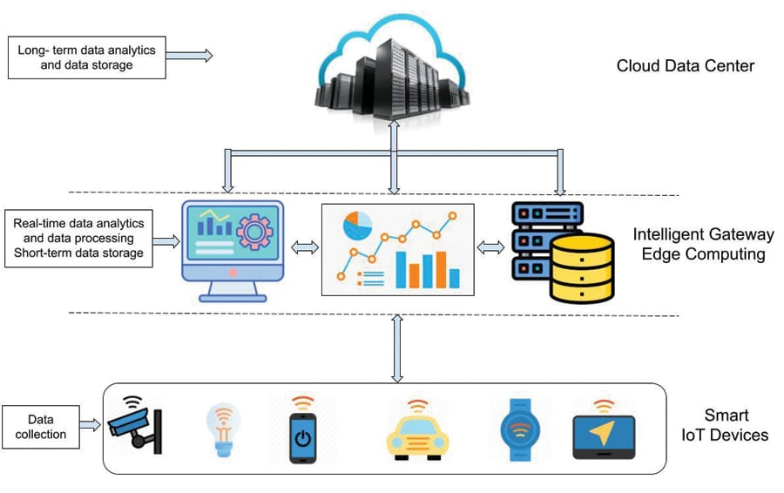
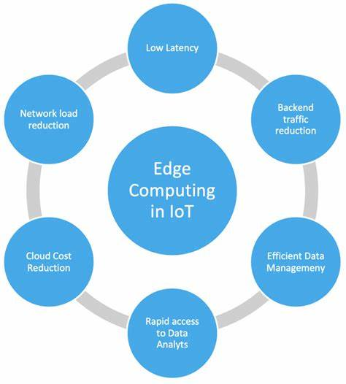
Edge Computing and IoT
Edge Computing is a paradigm that brings computation and data storage closer to the devices that generate the data, rather than relying on a centralized cloud.
This is particularly important for Internet of Things (IoT) devices, where real-time processing and low latency are crucial.
Edge AI techniques allow for on-device inference and decision-making, enabling new applications in smart homes, industrial automation, and autonomous systems.

Slide 8
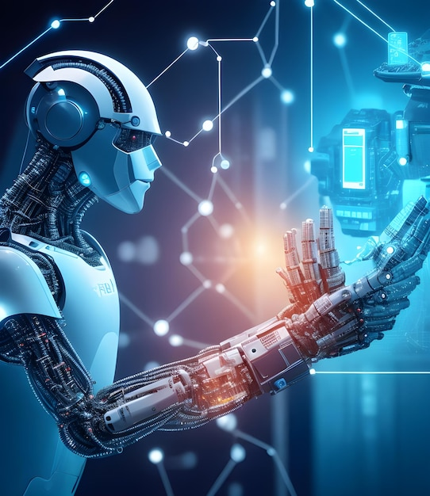
Conclusion
The field of Artificial Intelligence is continuously evolving, and the technologies discussed in this presentation represent some of the most exciting and impactful advancements.
As AI continues to progress, we can expect to see even more remarkable developments that will transform various industries and shape the future.

Slide 9


